Slide 1
WOXSEN UNIVERSITY | SCHOOL OF TECHNOLOGY
DATABASE MANAGEMENT SYSTEMS
ALUMNI MENTORING &
ENGAGEMENT MANAGEMENT SYSTEM
PROJECT-BASED LEARNING | FINAL REVIEW
Program: B.Tech – Artificial Intelligence
Academic Year: 2026–2027
Student: Nayan Mittal Roll No.: 25WU0102182
Section : AI-ML Leopards (Sem 3)
PRESENTATION

Slide 2
FINAL REVIEW
Project overview
THE PROBLEM
THE PROPOSED SYSTEM
THE PROTOTYPE
Alumni profiles, mentoring requests, donations and event details can be difficult to coordinate when kept separately.
A common data model and clear workflows for alumni registration, mentoring, mentor assignment and engagement reports.
A browser-based simulation demonstrates the main screens and client-side behaviour using JavaScript and local storage.
Project focus
• Connect DBMS concepts to a practical university alumni-engagement scenario.
• Design normalized relations with keys and integrity constraints.
• Clearly distinguish demonstrated prototype features from the planned SQL-backed implementation.
WOXSEN UNIVERSITY | SCHOOL OF TECHNOLOGY | DBMS PBL
02

Slide 3
FINAL REVIEW
Objectives and scope
OBJECTIVES
IN SCOPE
• Design an ER model and relational schema for the core entities.
• Define primary keys, foreign keys, uniqueness and domain checks.
• Normalize the proposed design up to Third Normal Form (3NF).
• Demonstrate the main workflows through the supplied interface.
• Specify database reports and test cases for a complete implementation.
Core records
Alumni, students, mentoring requests, donations and events.
Prototype workflows
Register alumni, submit requests, assign mentors, record donations and view reports.
Current limitation
The supplied simulation uses local storage; it does not connect to a live SQL database.
WOXSEN UNIVERSITY | SCHOOL OF TECHNOLOGY | DBMS PBL
03

Slide 4
FINAL REVIEW
Proposed solution and workflow
01
Register alumni
Capture name, email, graduation year and programme.
02
Submit request
Record student details and mentoring topic.
03
Assign mentor
Select a pending request and an alumni mentor.
04
Record donation
Choose an alumnus and enter a positive amount and date.
05
View reports
Review mentoring matches, donations and event capacity.
WOXSEN UNIVERSITY | SCHOOL OF TECHNOLOGY | DBMS PBL
04

Slide 5
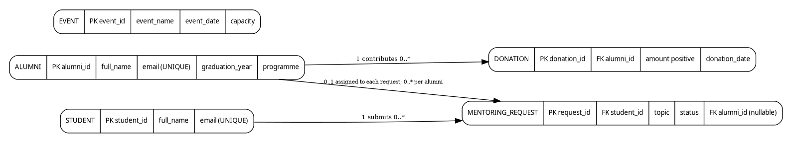
FINAL REVIEW
ER model and relationships
ALUMNI
Can mentor multiple requests and have multiple donation records.
STUDENT → REQUEST
One student may submit multiple mentoring requests; each request belongs to one student.
REQUEST → ALUMNI
A request may have zero or one assigned alumni mentor.
Events are represented as an independent entity in the proposed design.
WOXSEN UNIVERSITY | SCHOOL OF TECHNOLOGY | DBMS PBL
05

Slide 6
FINAL REVIEW
Logical database design
ALUMNI
alumni_id (PK), full_name, email (UNIQUE), graduation_year, programme
STUDENT
student_id (PK), full_name, email (UNIQUE)
MENTORING_REQUEST
request_id (PK), student_id (FK), topic, status, alumni_id (nullable FK)
DONATION
donation_id (PK), alumni_id (FK), amount, donation_date
EVENT
event_id (PK), event_name, event_date, capacity
Normalization: each relation is designed for 1NF, 2NF and 3NF based on the stated functional dependencies.
WOXSEN UNIVERSITY | SCHOOL OF TECHNOLOGY | DBMS PBL
06

Slide 7
FINAL REVIEW
Keys, constraints and normalization
IDENTITY
REFERENTIAL INTEGRITY
DOMAIN RULES
Primary keys uniquely identify each alumni, student, request, donation and event record.
Foreign keys connect requests to students and optional mentors, and donations to alumni.
Unique emails, required fields, valid request status, positive donation amount and non-negative event capacity.
NORMALIZATION SUMMARY
• 1NF: attributes hold single values and records are uniquely identified.
• 2NF: non-key attributes depend on the whole primary key; the design uses single-column keys.
• 3NF: descriptive attributes are stored with their own entity instead of being repeated in transaction records.
The schema is a proposed MySQL design; these constraints are not yet enforced by the HTML simulation.
WOXSEN UNIVERSITY | SCHOOL OF TECHNOLOGY | DBMS PBL
07

Slide 8
FINAL REVIEW
Application and database connectivity
USER INTERFACE
APPLICATION LOGIC
CURRENT STORAGE
HTML forms, navigation tabs and report tables.
→
JavaScript handlers validate inputs and refresh the visible interface.
→
Browser localStorage stores serialized JavaScript objects.
IMPORTANT IMPLEMENTATION STATUS
No SQL connector, backend API or live relational database connection is present in the supplied HTML. MySQL tables and SQL queries are the planned next step, not a completed integration.
This distinction is important for an accurate DBMS review: the prototype demonstrates interface workflows, while the logical schema defines the database-backed version.
WOXSEN UNIVERSITY | SCHOOL OF TECHNOLOGY | DBMS PBL
08

Slide 9
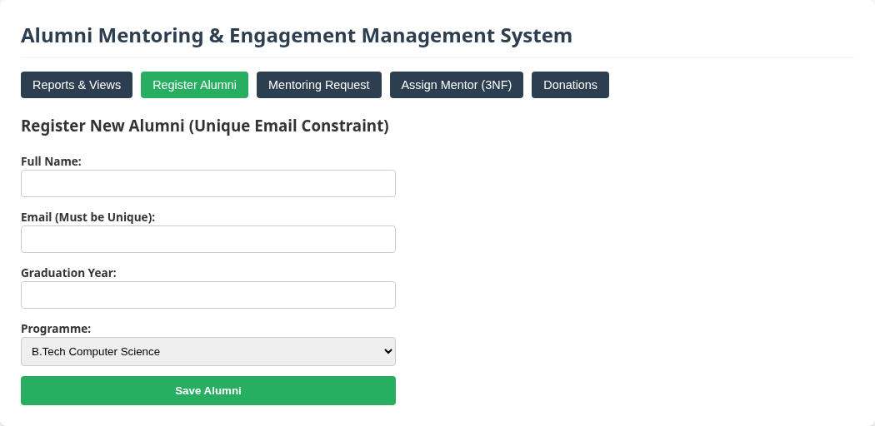
FINAL REVIEW
Application screen: alumni registration
INPUT FIELDS
Full name, unique email, graduation year and programme.
VALIDATION
Required fields and email format are checked by the browser; JavaScript rejects duplicate alumni emails.
Current behaviour: record is saved to localStorage, not SQL.
WOXSEN UNIVERSITY | SCHOOL OF TECHNOLOGY | DBMS PBL
09

Slide 10
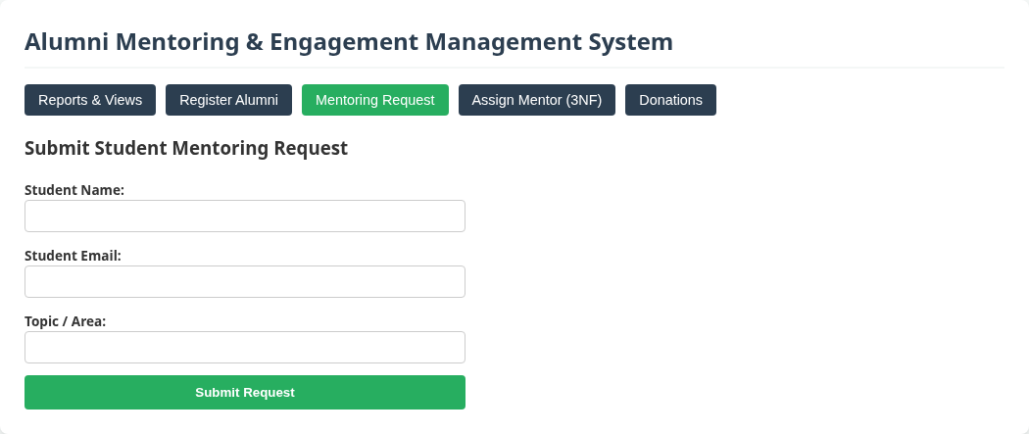
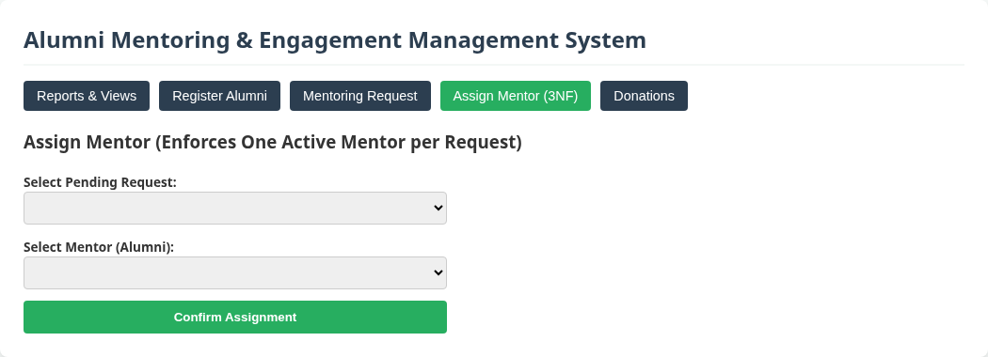
FINAL REVIEW
Application screens: mentoring workflow
SUBMIT MENTORING REQUEST
ASSIGN A MENTOR
The request workflow creates a Pending request; the assignment workflow changes its status to Assigned and links an alumni mentor in the prototype.
WOXSEN UNIVERSITY | SCHOOL OF TECHNOLOGY | DBMS PBL
10

Slide 11
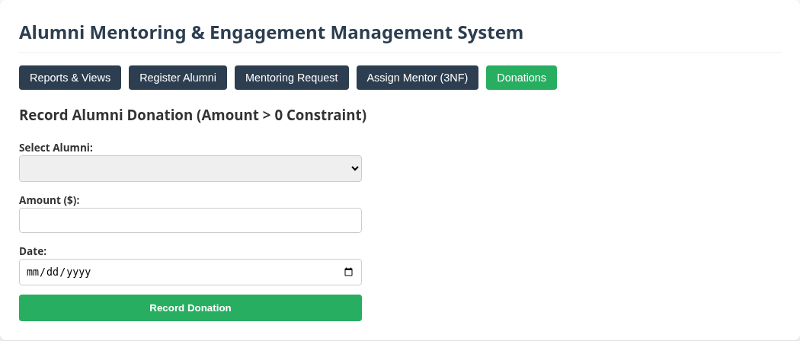
FINAL REVIEW
Application screen: donation entry
DONATION DATA
Select an alumni member, enter amount and date.
BUSINESS RULE
Donation amount must be greater than zero.
Prototype validation is client-side; SQL CHECK enforcement is planned.
WOXSEN UNIVERSITY | SCHOOL OF TECHNOLOGY | DBMS PBL
11

Slide 12
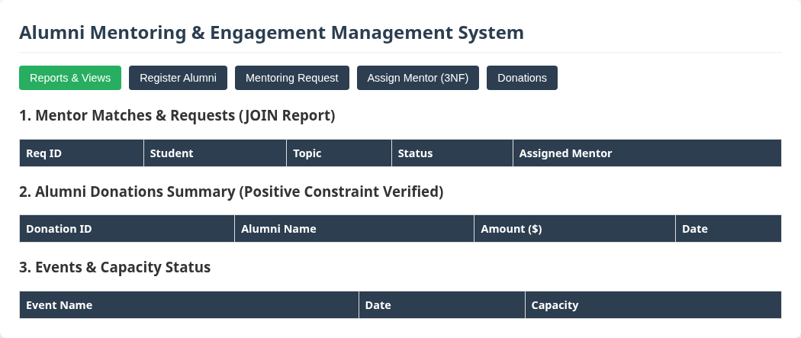
FINAL REVIEW
Application screen: reports and views
The dashboard displays mentor matches and requests, alumni donations, and event capacity using the current local data.
WOXSEN UNIVERSITY | SCHOOL OF TECHNOLOGY | DBMS PBL
12

Slide 13
FINAL REVIEW
CRUD operations and business rules
CREATE
READ
UPDATE
DELETE
Register alumni, submit mentoring requests and record donations.
Display requests, mentor names, donations and event details.
Assign a mentor and change a request from Pending to Assigned.
Not implemented in the supplied prototype.
VALIDATION DEMONSTRATED IN THE PROTOTYPE
• Duplicate alumni email is rejected with an error message.
• Required form fields and email input format are checked.
• Donation input has a positive minimum and a JavaScript amount check.
• Success/error messages appear after form actions.
SQL constraints, parameterized queries, transaction rollback and database exception handling remain future work.
WOXSEN UNIVERSITY | SCHOOL OF TECHNOLOGY | DBMS PBL
13

Slide 14
FINAL REVIEW
Reports and test coverage
MENTOR MATCH REPORT
DONATION SUMMARY
EVENT STATUS
Combines request, student and assigned mentor details; pending requests show no assigned mentor.
Shows donation ID, alumni name, amount and date.
Shows event name, date and capacity.
TEST CASES DEFINED
• TC-01: Reports render the seeded records.
• TC-02 / TC-03: New alumni registration and duplicate-email rejection.
• TC-04 / TC-05: Mentoring request submission and mentor assignment.
• TC-06 / TC-07: Invalid donation rejection and positive donation entry.
Results are based on code-path inspection and visible prototype behaviour; SQL-level testing has not been performed.
WOXSEN UNIVERSITY | SCHOOL OF TECHNOLOGY | DBMS PBL
14

Slide 15
FINAL REVIEW
Limitations and future enhancements
CURRENT LIMITATIONS
DATABASE INTEGRATION
FURTHER IMPROVEMENTS
• Local browser storage only
• No SQL database connection
• No delete workflow
• No authentication or role management
• Create the five MySQL tables
• Add a backend/API and connector
• Enforce PK, FK, UNIQUE and CHECK rules
• Use parameterized SQL
• Add edit/delete with confirmation
• Add authentication and access roles
• Add event registration and capacity checks
• Generate downloadable reports
Implementation priority
Connect the existing workflows to a relational database first, then verify each business rule with positive and negative SQL-backed test cases.
WOXSEN UNIVERSITY | SCHOOL OF TECHNOLOGY | DBMS PBL
15

Slide 16
FINAL REVIEW
Conclusion
• The project models alumni engagement through five core entities and their relationships.
• The proposed relational design defines keys, integrity constraints and normalization through 3NF.
• The supplied simulation demonstrates the key workflows and report screens.
• A live SQL connection is the main next step before the prototype can be considered a complete DBMS application.
Thank you | Questions
WOXSEN UNIVERSITY | SCHOOL OF TECHNOLOGY

